Slide 1
Generic classes & methods

Slide 2
What is generic?
A class or method that doesn’t care what data type it is comprised of.
At compile time, the compiler will create every necessary class type for you.

Slide 3
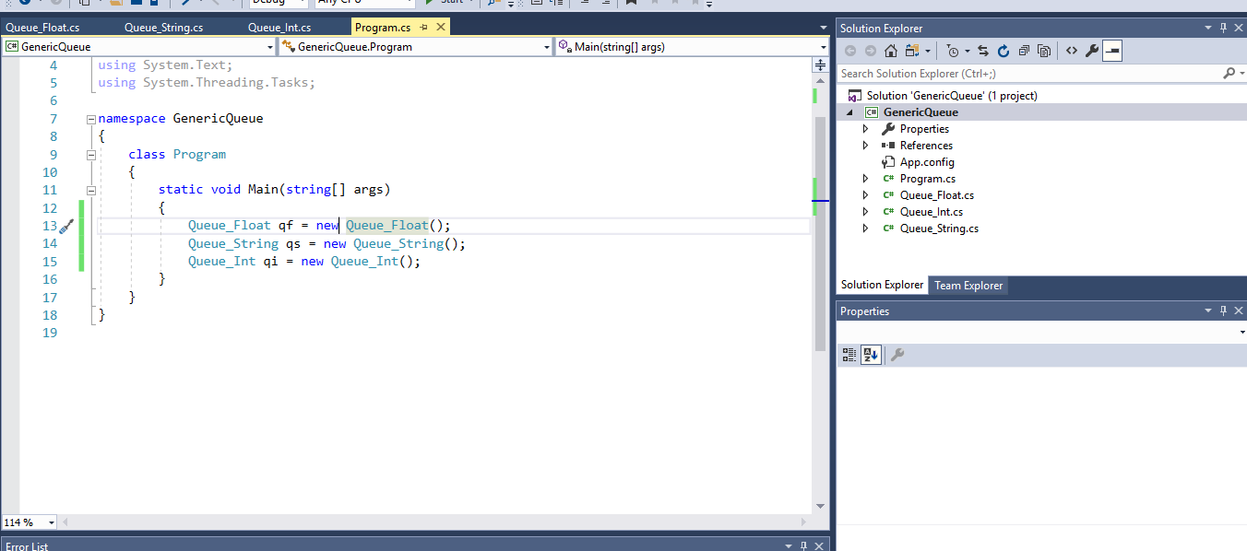
The wrong way

Slide 4
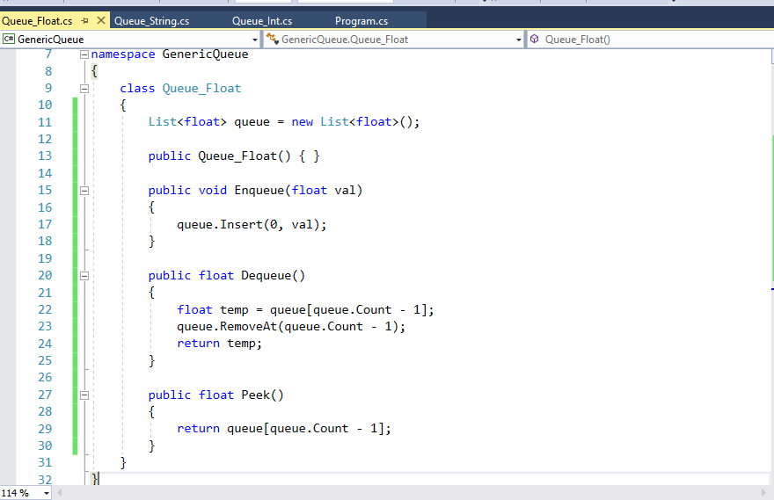
The wrong way

Slide 5
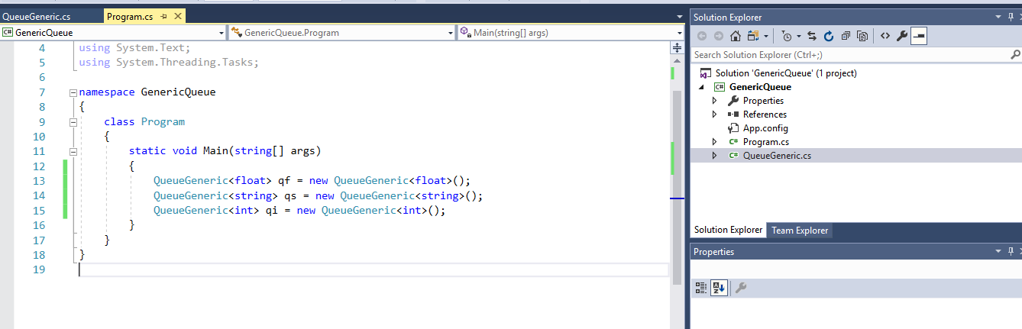
The right way

Slide 6
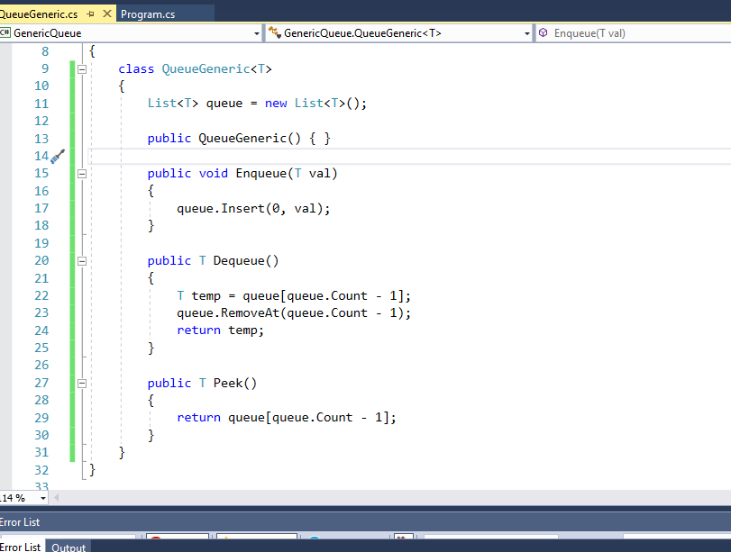
The right way

Slide 7
Generic Methods
Instead of writing a method 50 times for 50 different data types, write it once!

Slide 8
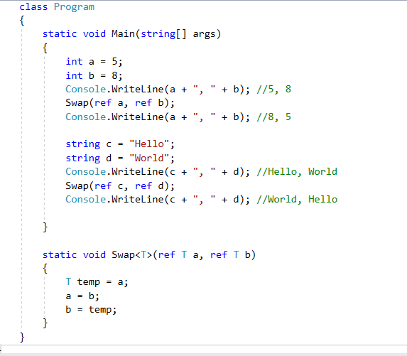

Slide 9
Interfaces
Similar to abstract classes.
Forces an object to implement certain behaviors.
Creates polymorphism among similar objects.
While you can only ever inherit from 1 class, you can inherit from unlimited interfaces.

Slide 10
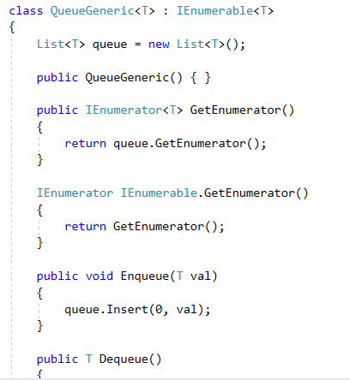
IEnumerable
Very common.
Forces your class to be enumerable
Enumerable means that it can be iterated through (like a list).

Slide 11
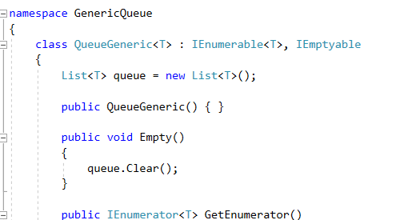
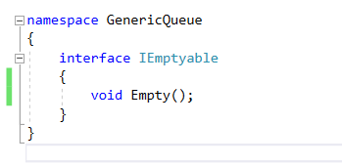
Custom interfaces
Lets us dictate what we can and cannot do with our code.

Slide 12
Example
Utilities class.
Contains lots of functions that are used regularly throughout your program.
Example: Print method for anything inheriting from IEnumerable

Slide 13
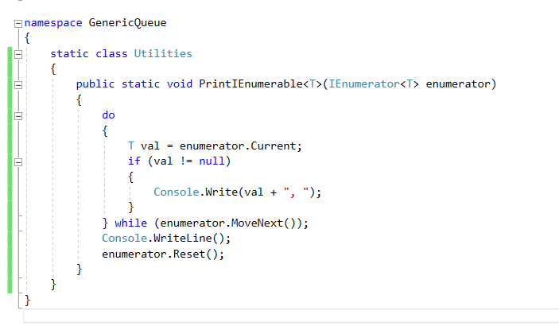

Slide 14
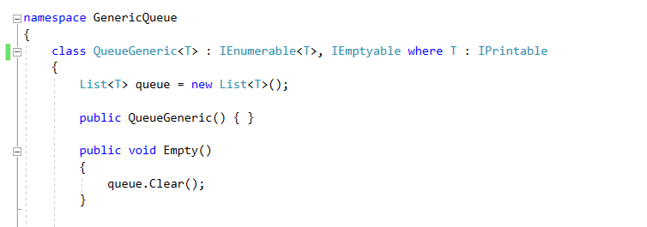
Requiring behaviors of T
Sometimes, you want to require that every generic class “T” that you handle has certain behaviors.
Perhaps we want every type of T to be easily printable.
So we require that every T inherits from IPrintable

Slide 15
Real world example
Demo of thesis
https://github.com/darrare/MS-Thesis

